Slide 1
Galaxy Dynamics
James Wells

Slide 2
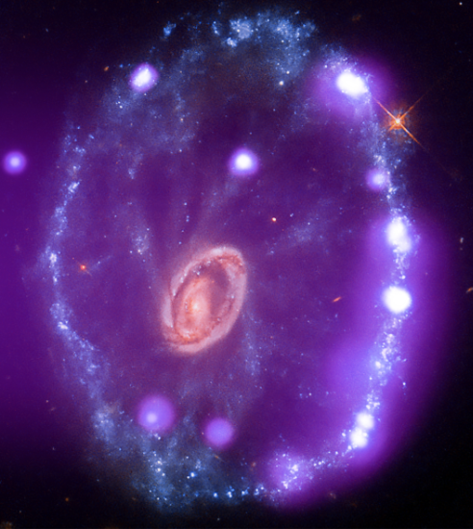
Agenda
Meet NGC3741
Far Far Away
Finding Velocity
Mass? What Mass?
A Problem in Astrophysics
Xray of Bull’s Eye cartwheel galaxy from Chandra,
Image: NASA

Slide 3
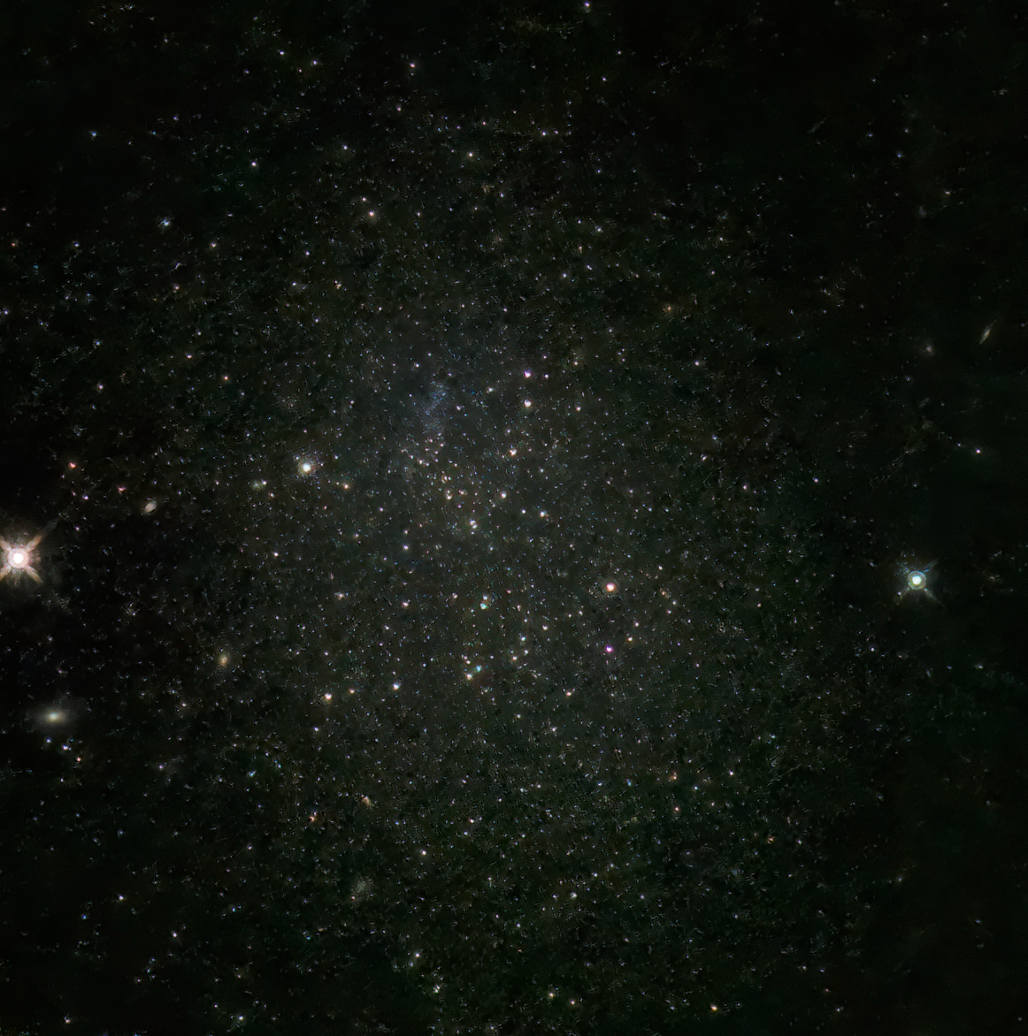
Introduction
This semester I have been participating in undergraduate research with Professor Liese Van Zee and PhD student Lexi Gault on Hα Outflow and galactic turbulence in nearby dwarf galaxies.
For this project I attempted to use observational data collected on galaxy NGC3741, in conjunction with topics we learned about in P221 to determine Mass, Velocity, Radius, and Angular Momentum of the galaxy.
Image Credit: John Bozeman

Slide 4
Topic one
Meet NGC3741

Slide 5
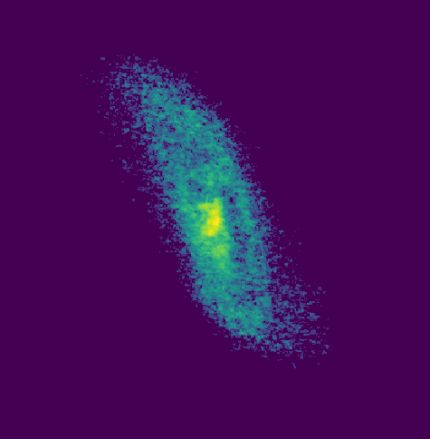
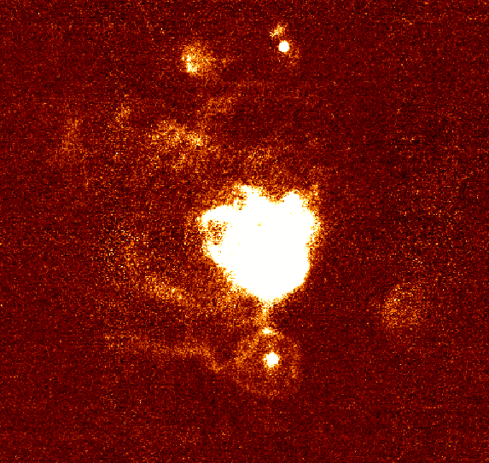
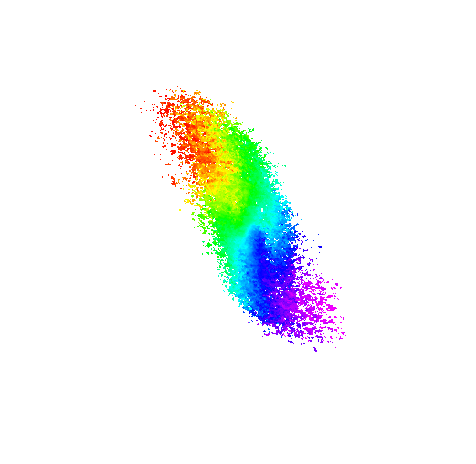
NGC3741
“Nearby” dwarf galaxy
3.2 Mega-Parsecs from Earth
Axis is tilted from view of Earth (nearly side on)
H1 Distribution
Hα Distribution
Velocity Histogram

Slide 6
Topic TWO
Far Far Away

Slide 7
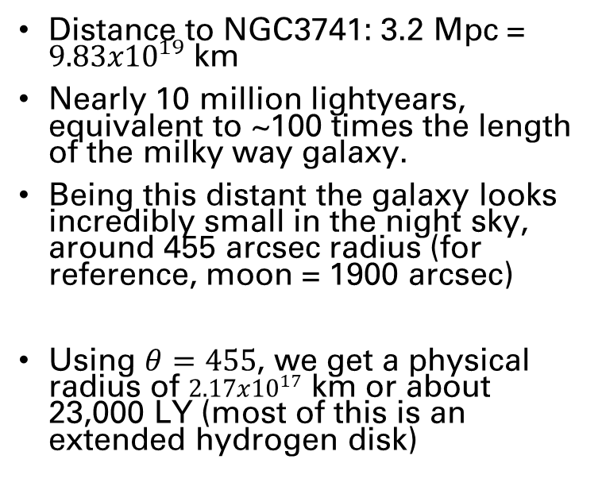
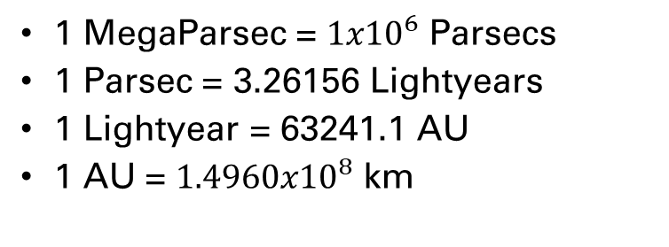
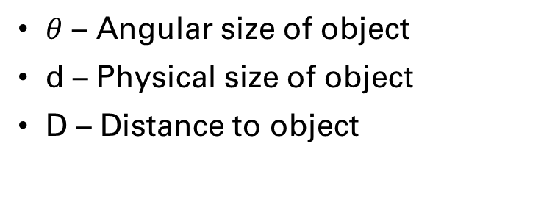
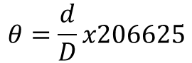
Galactic Size Scales
Conversions
Our Data
1 MegaParsec = ${1x10}^{6}$ Parsecs
1 Parsec = 3.26156 Lightyears
1 Lightyear = 63241.1 AU
1 AU = ${1.4960x10}^{8}$ km
Distance to NGC3741: 3.2 Mpc = ${9.83x10}^{19}$ km
Nearly 10 million lightyears, equivalent to ~100 times the length of the milky way galaxy.
Being this distant the galaxy looks incredibly small in the night sky, around 455 arcsec radius (for reference, moon = 1900 arcsec)
Using $θ=455$, we get a physical radius of ${2.17x10}^{17}$ km or about 23,000 LY (most of this is an extended hydrogen disk)
Calculations
$θ$ – Angular size of object
d – Physical size of object
D – Distance to object
$$θ=\frac{d}{D}x206625$$

Slide 8
Topic three
Finding Velocity

Slide 9
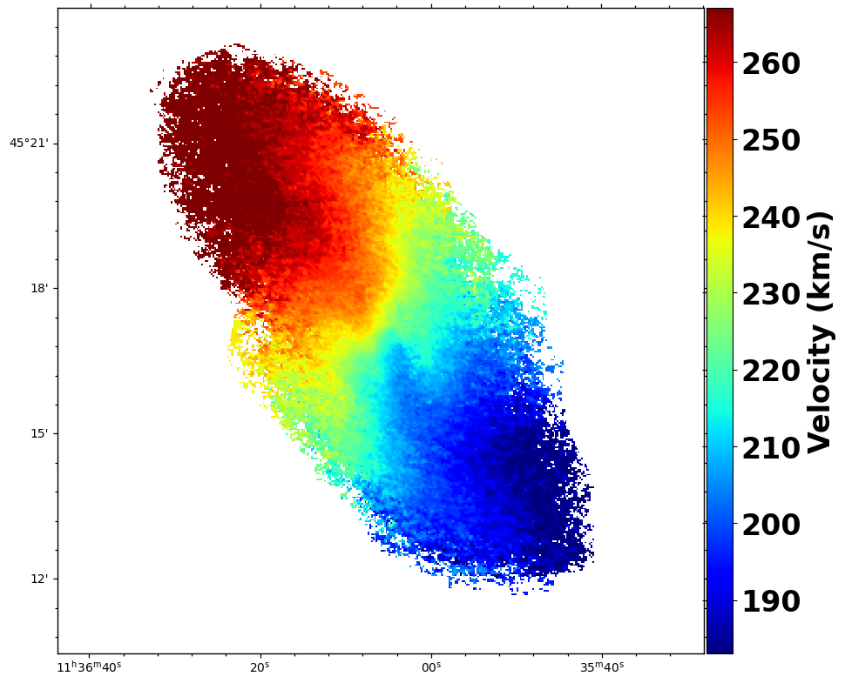
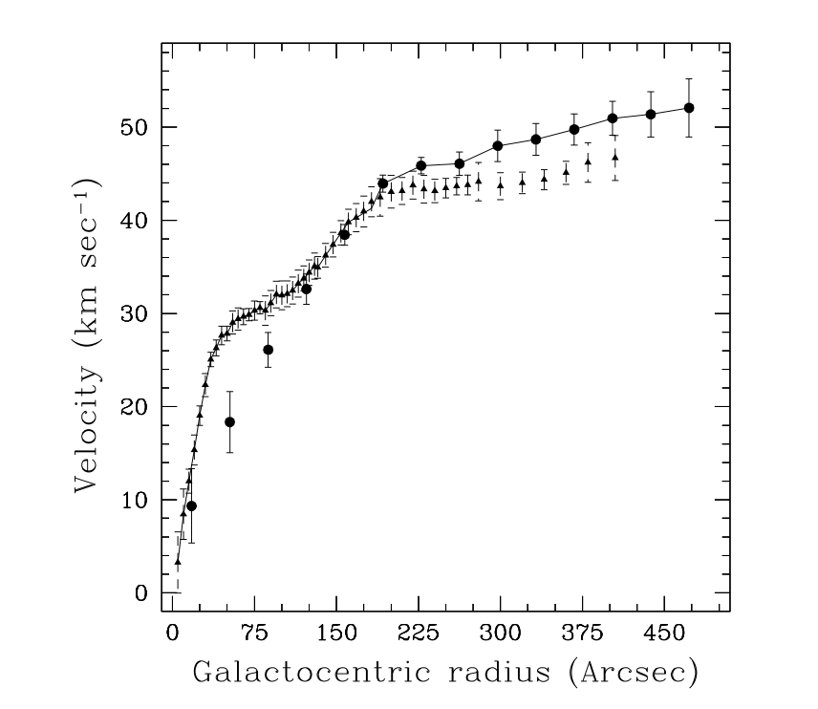
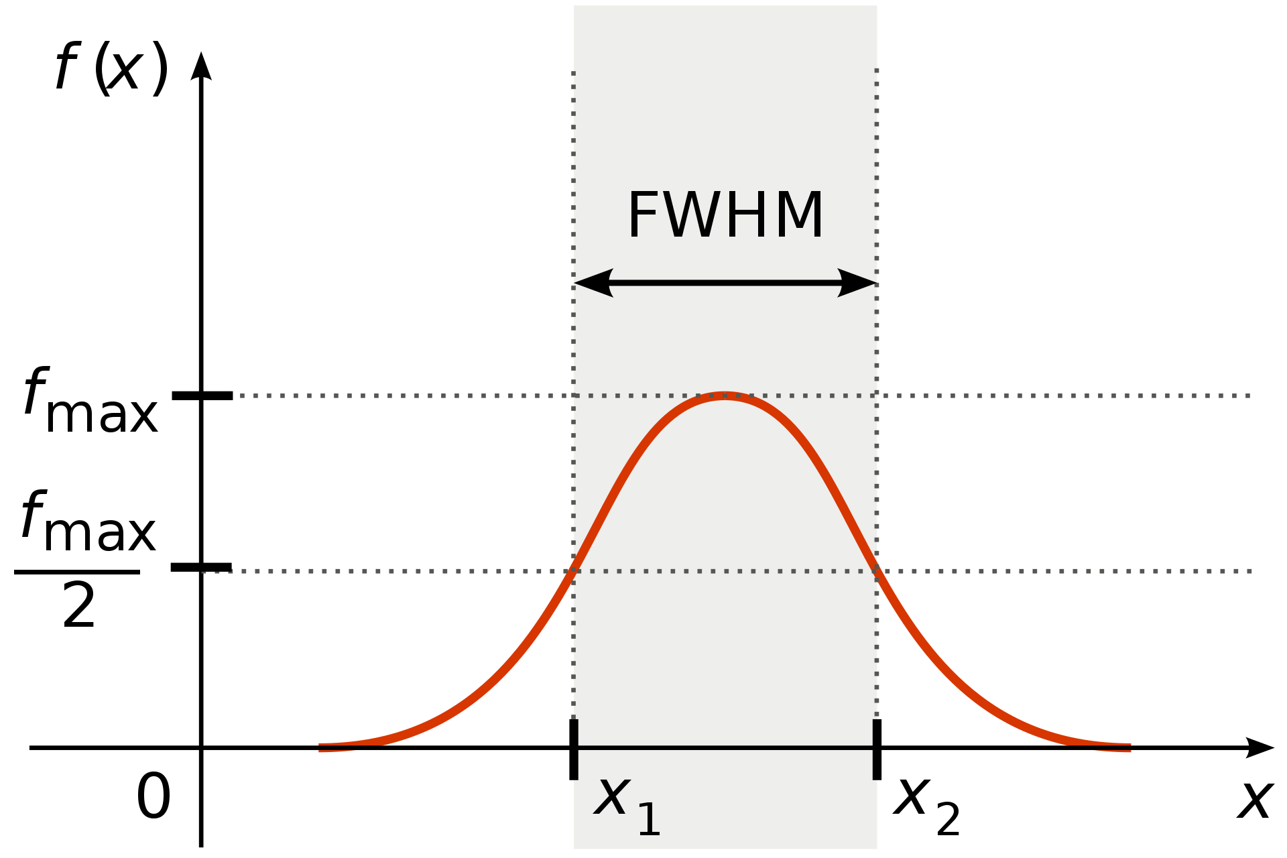
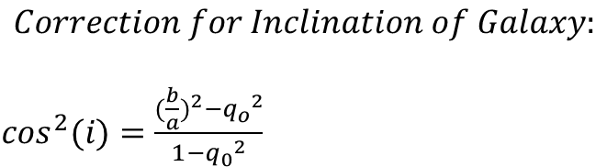
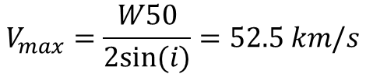
Finding Velocity
Velocity Field
Two main ways to find velocity: FWHM and Velocity Field/Rotational curve overlay
Full Width Half Maximum
Rotational Curve
$$Correction for Inclination of Galaxy:$$
$\cos^{2}(i)=\frac{{(\frac{b}{a})}^{2}−{q_{o}}^{2}}{1−{q_{0}}^{2}}$
a=major axis
b=semimajor axis
q=thickness of disk
$${FWHM\left(W50\right)=2V}_{max}\sin\left(i\right) , i=47−64$$
$$V_{max}=\frac{W50}{2sin⁡(i)}=52.5 km/s$$
By Arne Nordmann
“Begum et Al 2008”
“Begum et Al 2008”

Slide 10
Topic Four
Mass? What Mass?

Slide 11
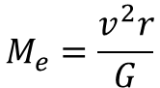
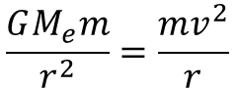
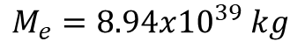
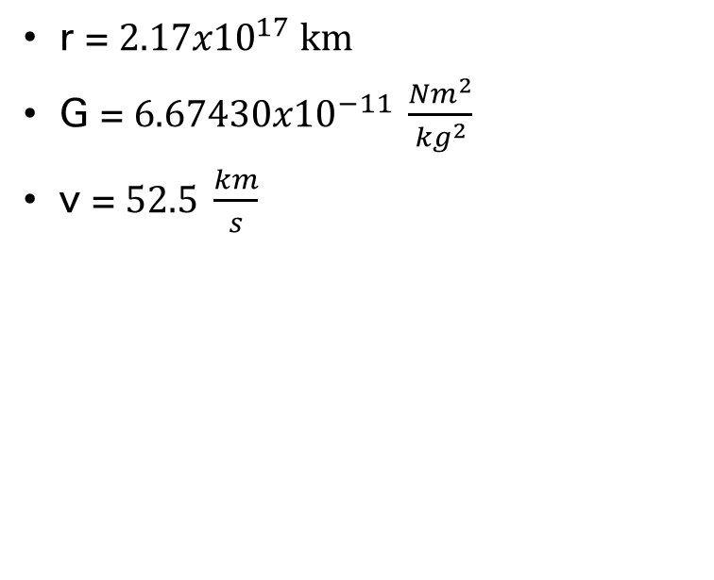
Finding Enclosed Mass
Gravitational Force between two bodies
Me (Enclosed Mass)
Total Mass required for the self gravity of the galaxy to retain objects within the given radius and velocity parameters.
$$\frac{GM_{e}m}{r^{2}}=\frac{mv^{2}}{r}$$
r = ${2.17x10}^{17} km$
G = ${6.67430x10}^{−11} \frac{{Nm}^{2}}{{kg}^{2}}$
v = $52.5 \frac{km}{s}$
$$M_{e}=\frac{v^{2}r}{G}$$
$M_{e}=8.94x{10}^{39} kg$

Slide 12
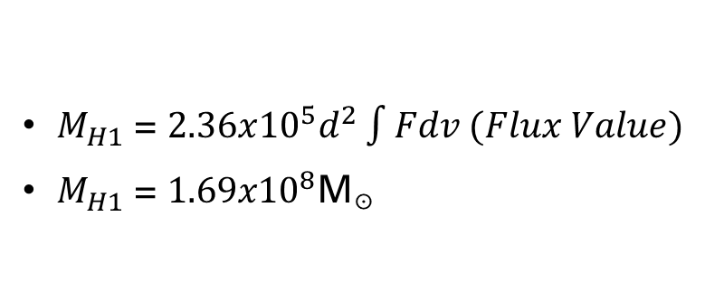
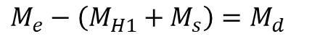
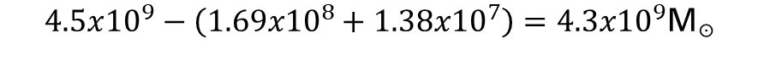
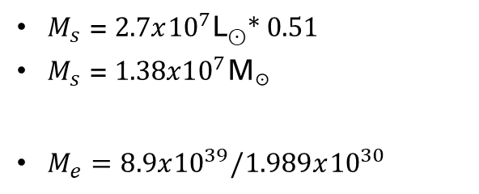
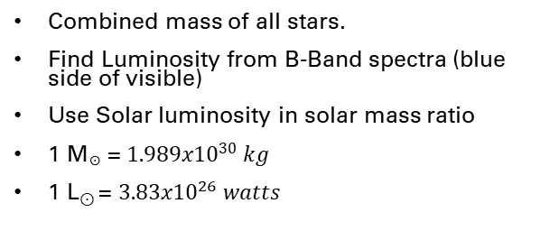
Observable Mass
Ms (Stellar Mass)
MH1 (Hydrogen Gas)
Mi (Hot Ionized Gas)
Combined mass of all stars.
Find Luminosity from B-Band spectra (blue side of visible)
Use Solar luminosity in solar mass ratio
1 M☉ = ${1.989x10}^{30} kg$
1 L⊙ = ${3.83x10}^{26} watts$
Total Mass required for the self gravity of the galaxy to retain objects within its radius.
Ionized gasses/other elements make up a negligible amount of total galactic mass.
$M_{s}$ = $2.7x{10}^{7}\text{L}\text{⊙}$* 0.51
$M_{s}$ = ${1.38x10}^{7}\text{M}\text{☉}$
$M_{e}=8.9x{10}^{39}/1.989x{10}^{30}$
$M_{H1}$ = $2.36x{10}^{5}d^{2}\int{Fdv (Flux Value)}$
$M_{H1}$ = ${1.69x10}^{8}\text{M}\text{☉}$
$M_{e}−\left(M_{H1}+M_{s}\right)=M_{d}$
$$4.5x{10}^{9}−\left({1.69x10}^{8}+{1.38x10}^{7}\right)={4.3x10}^{9}\text{M}\text{☉}$$

Slide 13
Topic five
A Problem in Astrophysics

Slide 14
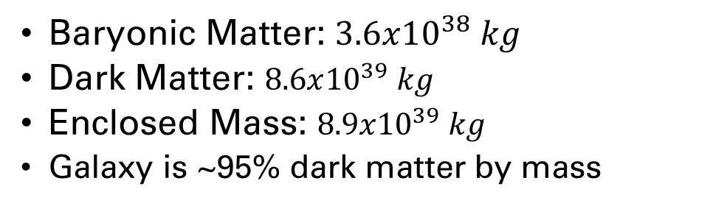
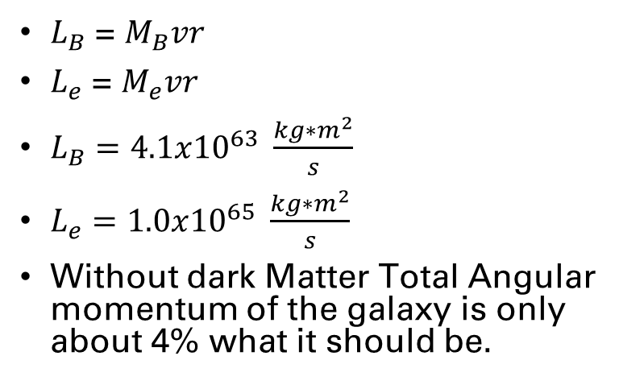
Angular Momentum & Darkmatter
Mass Distribution:
Angular Momentum
Baryonic Matter: $3.6x{10}^{38} kg$
Dark Matter: $8.6x{10}^{39} kg$
Enclosed Mass: $8.9x{10}^{39} kg$
Galaxy is ~95% dark matter by mass
$L_{B}$ = $M_{B}vr$
$L_{e}$ = $M_{e}vr$
$L_{B}=4.1x{10}^{63} \frac{kg∗m^{2}}{s}$
$L_{e}=1.0x{10}^{65} \frac{kg∗m^{2}}{s}$
Without dark Matter Total Angular momentum of the galaxy is only about 4% what it should be.

Slide 15
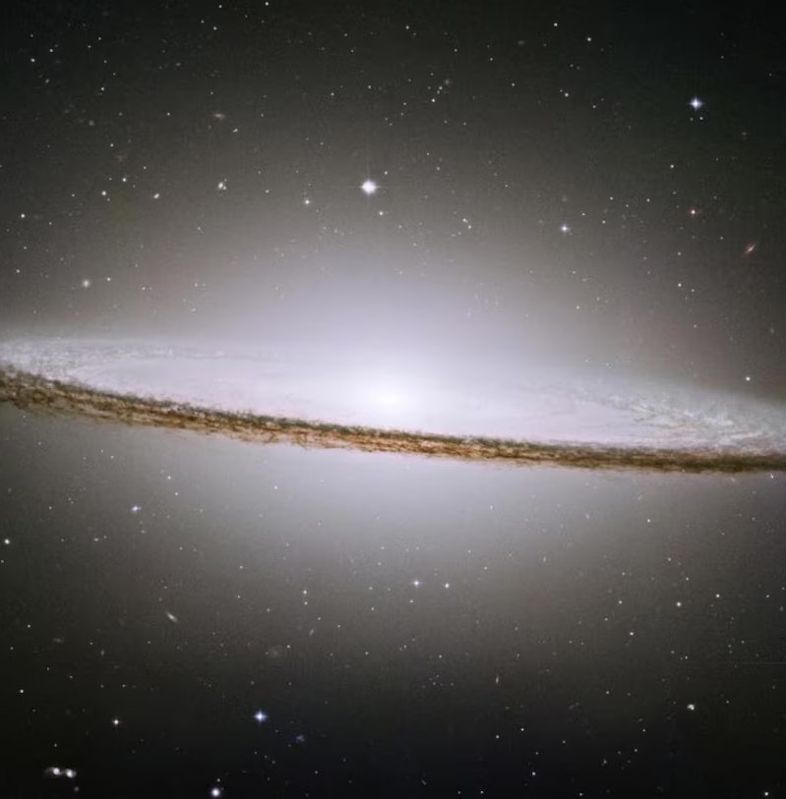
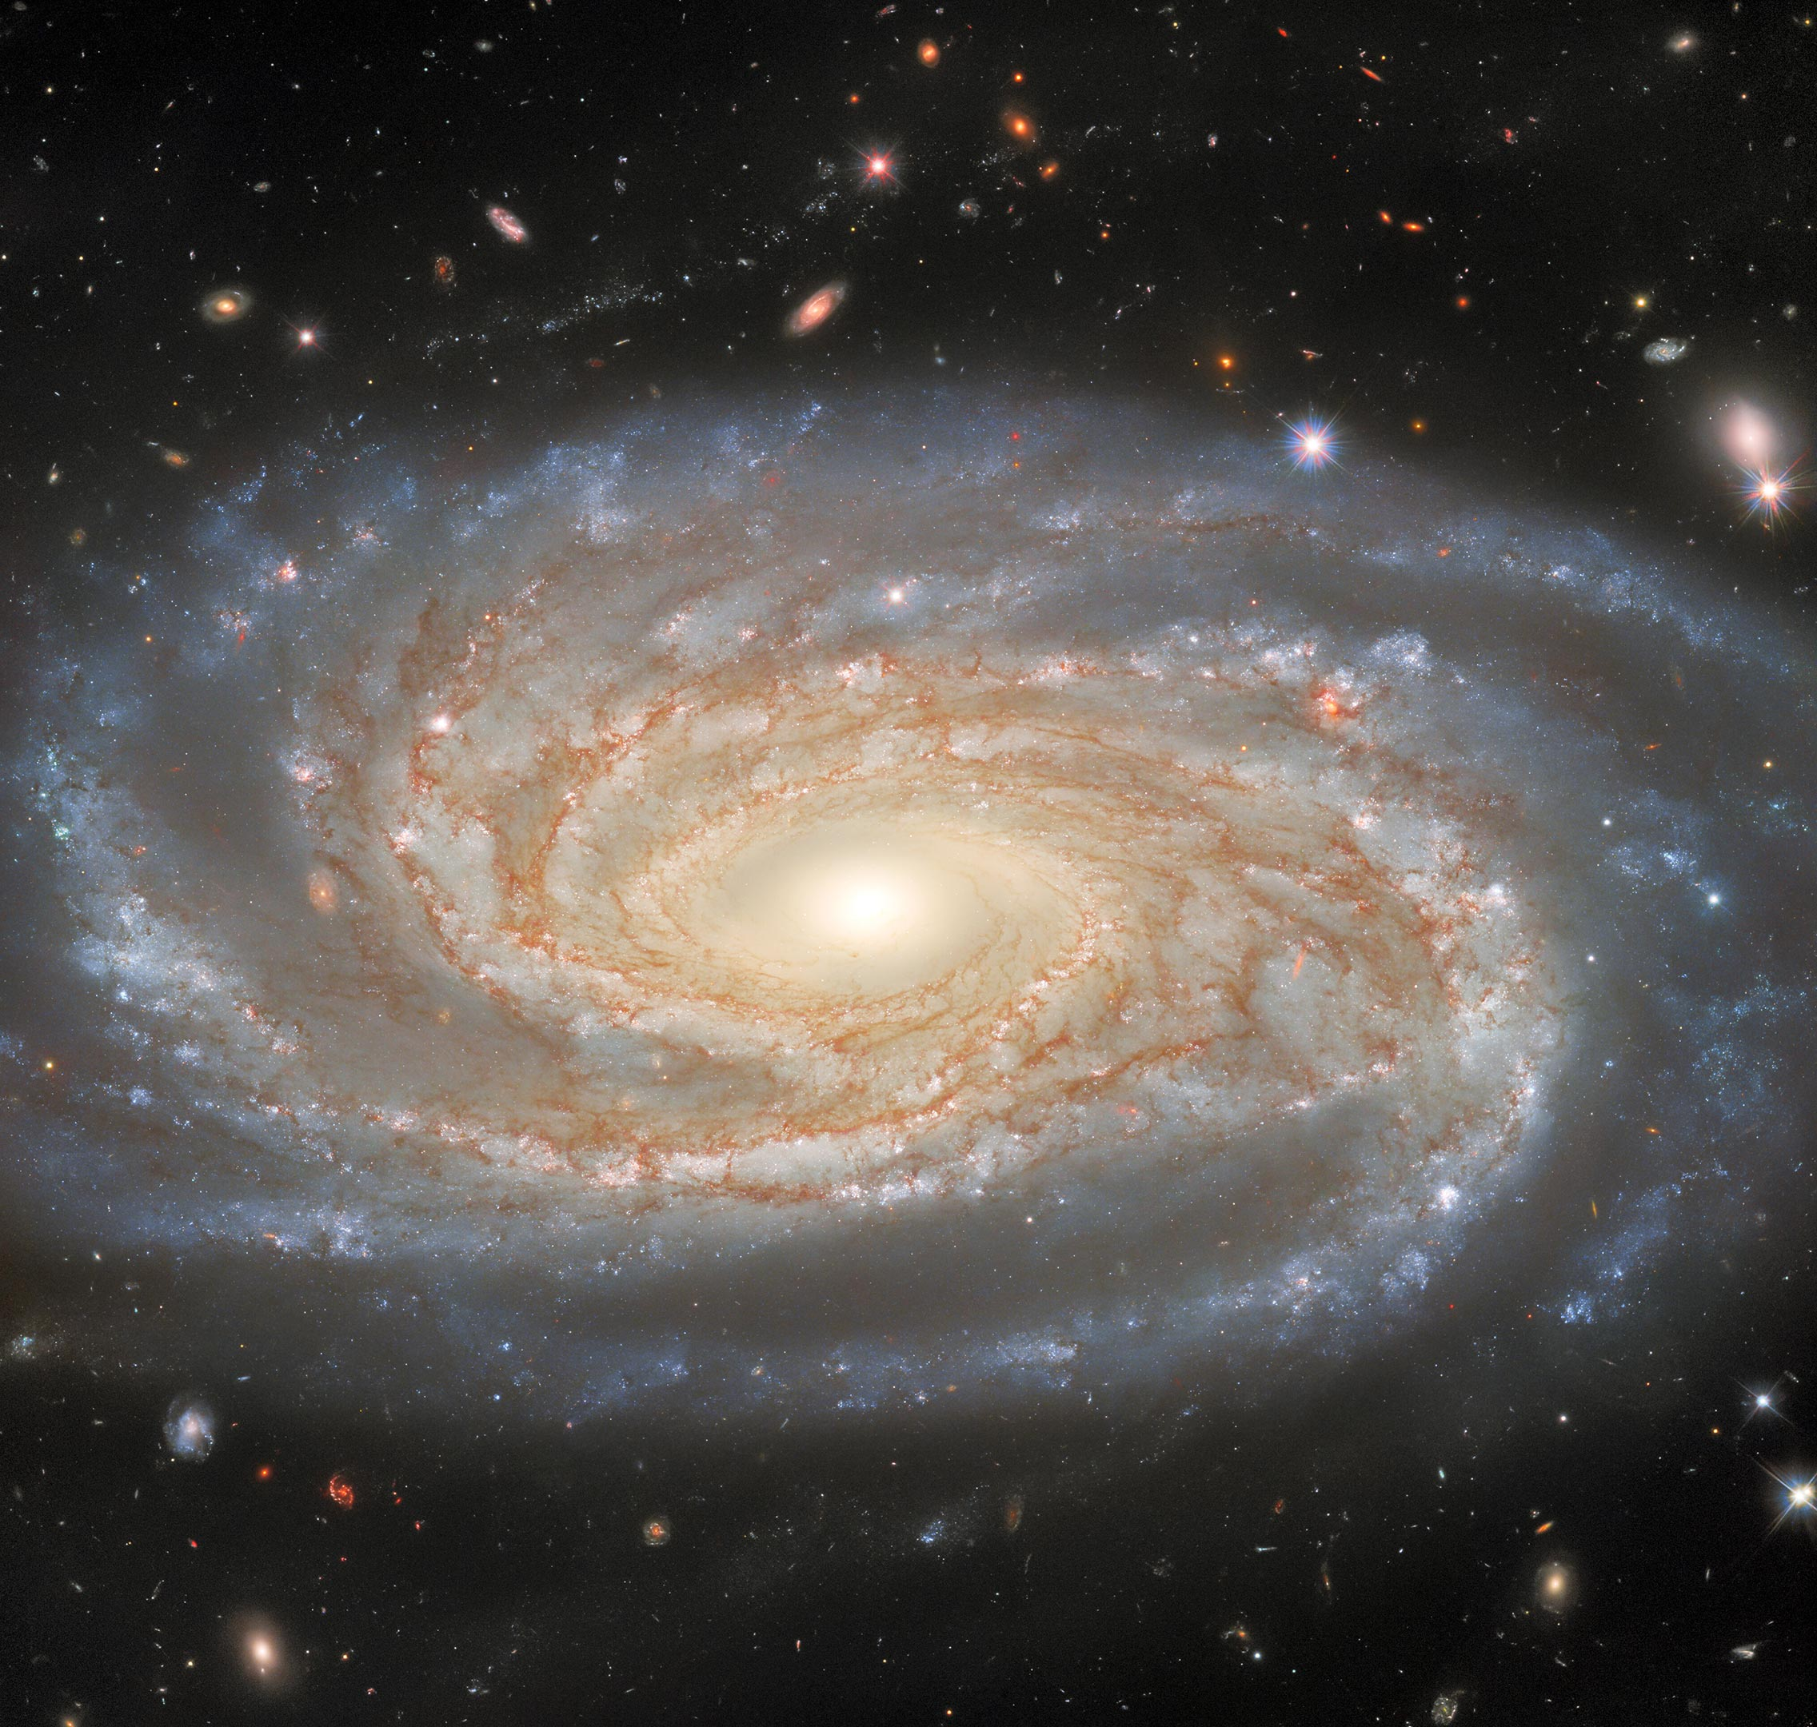
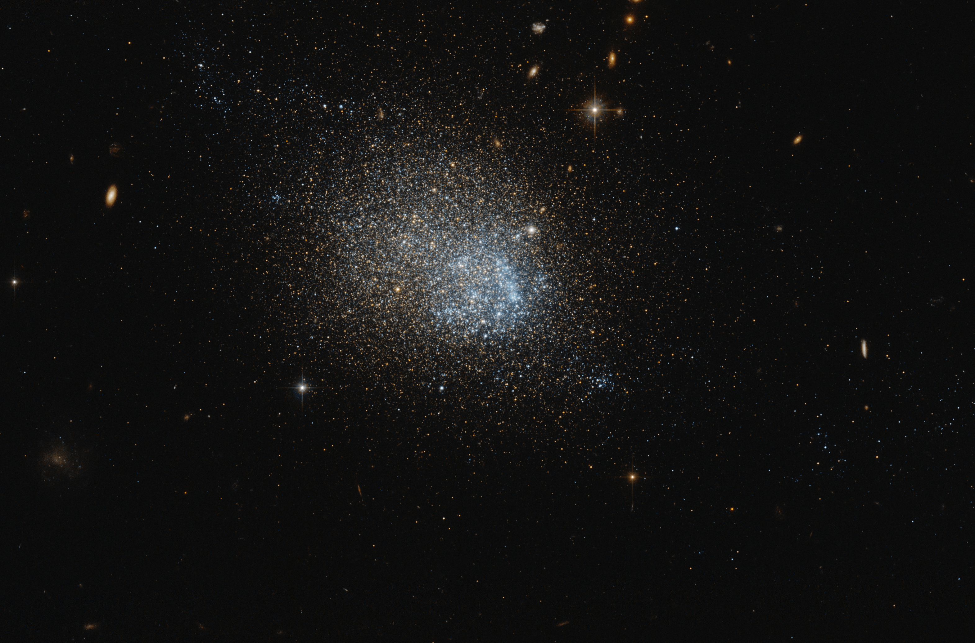
Summary
With relatively simply physics and good observational data we can not only determine the sizes, masses, and velocities of galaxies millions of lightyears from us. But also question the nature of what we can’t see with Dark Matter and measure its affect on the universe around us.
Image: National Geographic
Image: Judy Schmidt

Slide 16



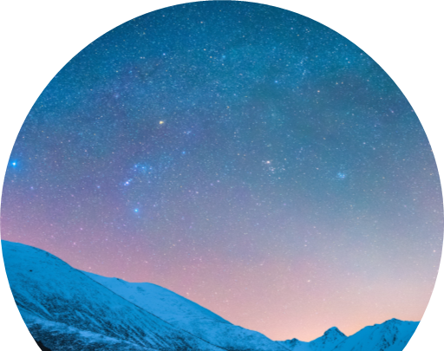
Thank you
James Wells

Slide 17
References:
Life in the last lane: star formation and chemical evolution in an extremely gas rich dwarf A. Begum et Al, 2008
A dwarf galaxy with a giant H1 disk
Begum et Al, 2005
Image References:
NASA
National Geographic
John Bozeman
Judy Schmidt
WIYN 3.5m telescope (IU Astronomy Dept, Prof Liese Van Zee)

